Slide 1

















Ball-by-Ball
Data Analysis
An end-to-end analytical dashboard covering teams, players, venues, and match trends across all IPL seasons.
2008-2024
Analysis by:
Abhishek Kr Singh
Email:
aks.abhishekkrsingh2310@gmail.com

Slide 2
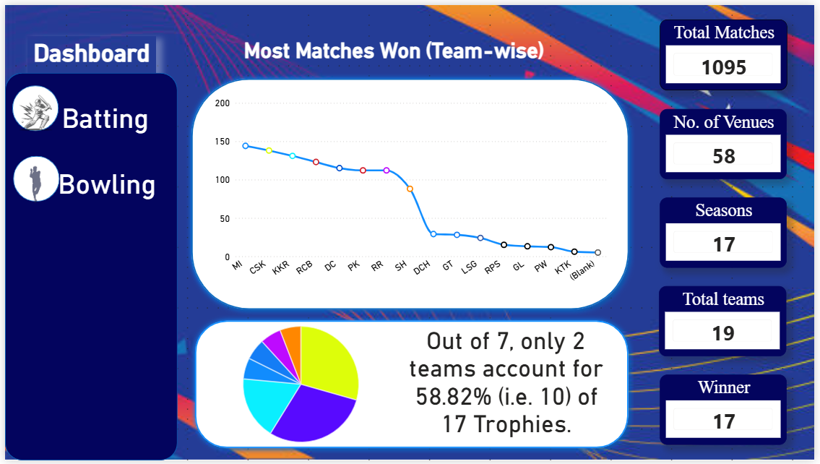

Slide 3
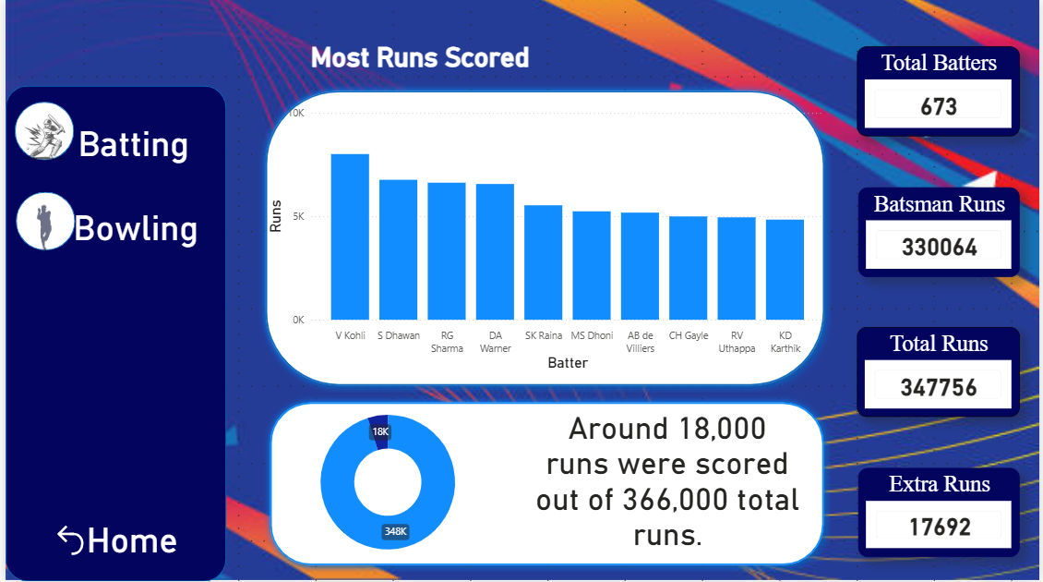

Slide 4
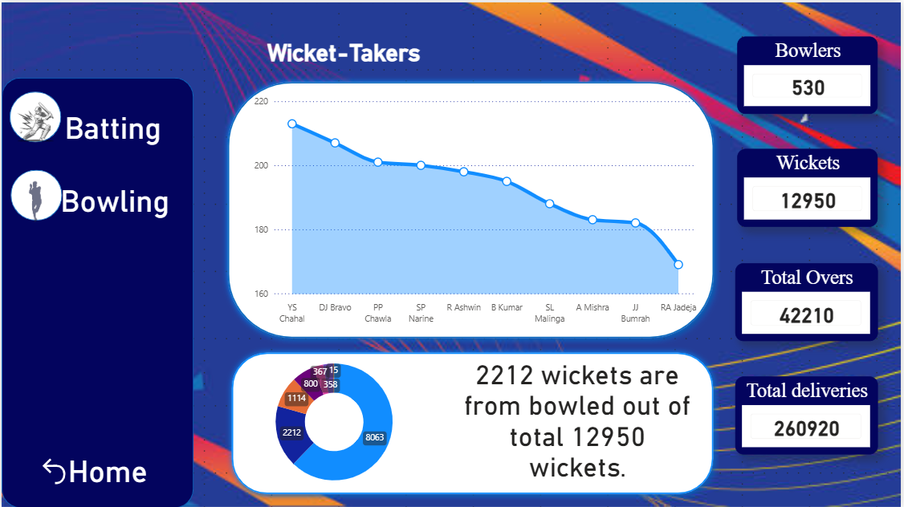

Slide 5
